Slide 1

5S
Practice of Good Housekeeping

Slide 2
5S NUMBER GAME!
Notes:
Ipakita nang mabilis ang next slide.
Magpapakita ako sa inyo ng ganito kagulong numbers. Ang goal ninyo is makita ang numbers 1 – 10 in 20 seconds. Para sa game na ito, kailangan ko ng volunteer.

Slide 3
48
30
87
33
45
72
3
69
27
51
21
57
24
18
75
9
6
78
54
60
63
36
12
15
42
81
39
66
84
90
2
68
77
80
53
74
86
62
29
65
5
20
41
23
56
32
44
35
89
83
8
50
47
11
26
17
38
14
59
71
64
49
31
61
34
28
54
40
16
7
52
10
58
76
22
88
73
1
85
82
4
43
25
19
37
13
67
79
46
70
Notes:
Magpapakita ako sa inyo ng ganito kagulong numbers. Ang goal ninyo is makita ang numbers 5, 21, 9 in 20 seconds.

Slide 4
WHAT IS 5S?
5S is a system to reduce waste and optimize efficiency through maintaining an orderly workplace.
Notes:
5S was adapted from Japanese. Made popular by Toyota. They thought of ways on how to reduce cost, reduce waste, while producing more products.
Reduce waste – Nakakatulong ang 5S para mabawasan yung kalat na tinatapon natin. The more na maraming kalat na tinatapon, the more na hindi tayo nakakatulong sa environment.
Optimize efficiency - Efficiency means achieving maximum productivity with minimum wasted effort or expense. For example, makakatulong to para pag may nawawalang gamit, madali nating makikita. Hindi yung we’ve wasted an hour hindi pa rin natin makita yung nawawalang yon, in that way magiging productive tayo to the important things we doAno pa, by reusing or recycling materials, nakakatipid tayo, or nakakatulong tayo sa company by cutting office expenses.

Slide 5
5S PHILOSOPHY
Goal of the 5S program is to make the work area the most efficient and productive as possible.
Productivity is the elimination of waste.
There is cost associated with waste.

Slide 6
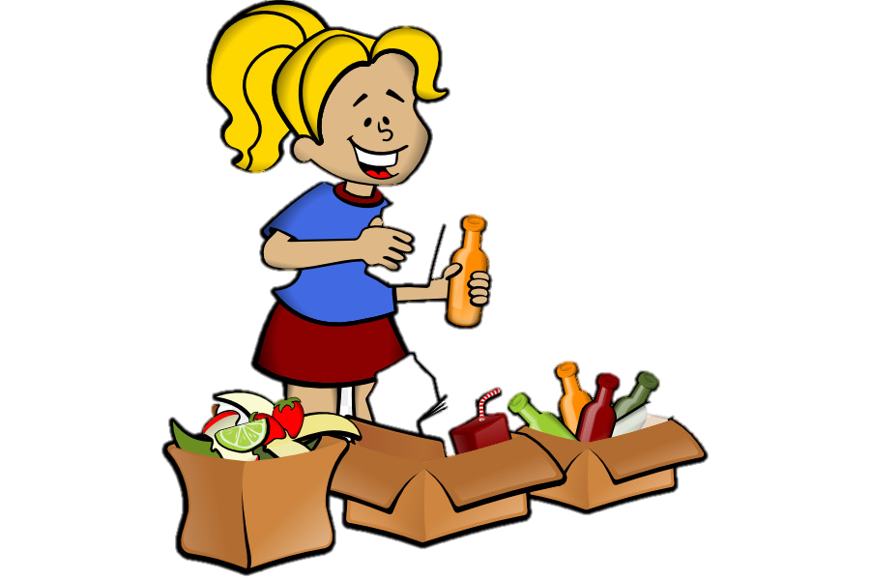
S-1 SEIRI (SORT)
Focuses on eliminating unnecessary items from the workplace
Categorize equipment, furniture, tool in your working place into the following 3 categories:
1. Necessary
2. Unnecessary
3. May not necessary

Slide 7
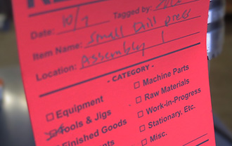
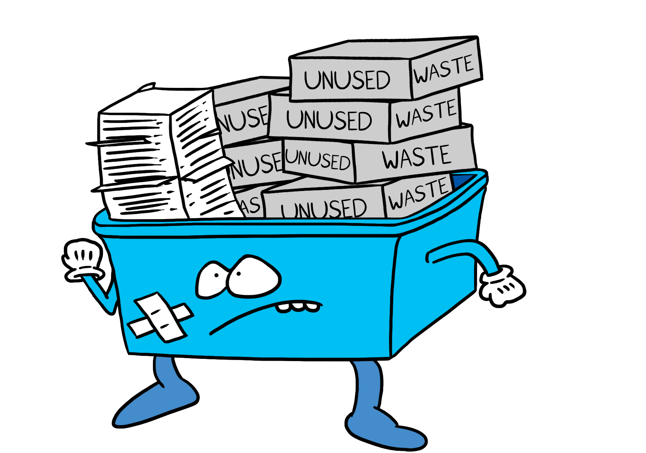

S-1 SORT EXAMPLES
Placing Red Tags
Move unnecessary items to central stored area
Space Utilization

Slide 8
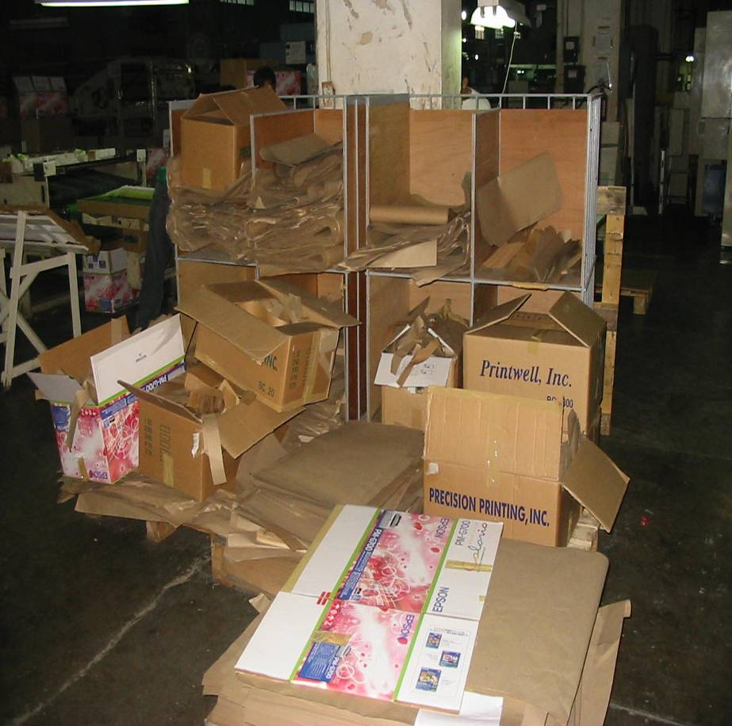
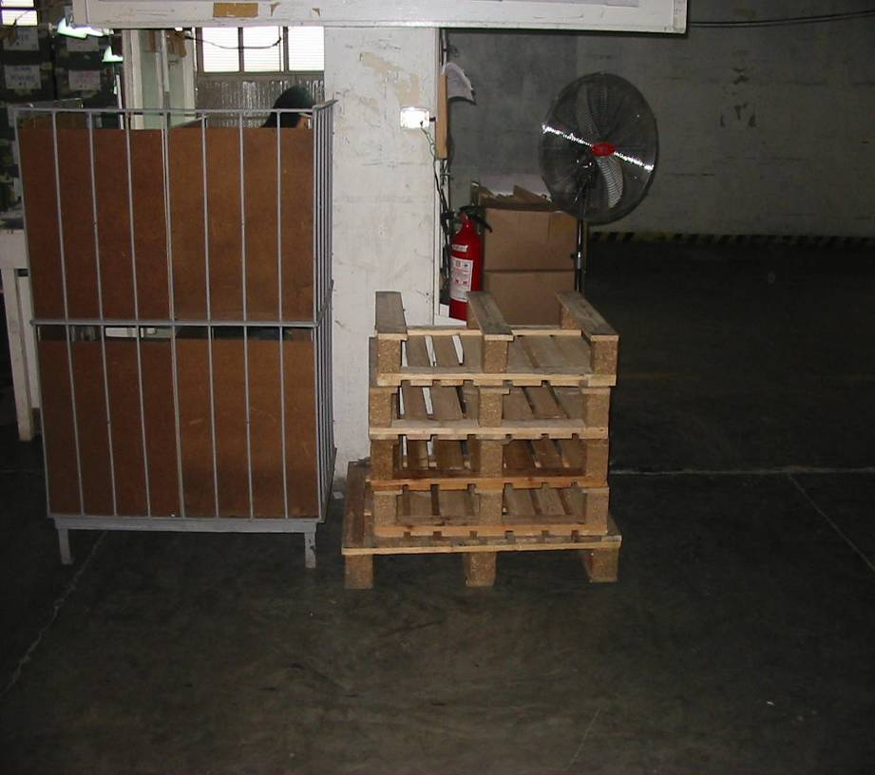
S-1 SORT EXAMPLES
Sort and Recycle
After
Before

Slide 9

S-2 SEITON (SYSTEMATIC ARRANGEMENT)
“to arrange necessary items in proper order so that they can be easily picked up for use”
Frequently used items
Rarely used items
Near to you
Far from you

Slide 10
S-2 SEITON (SYSTEMATIC ARRANGEMENT)
Use 5S tools for proper organization of items such as:
Labeling
Color coding
Numbering
Zoning etc.

Slide 11
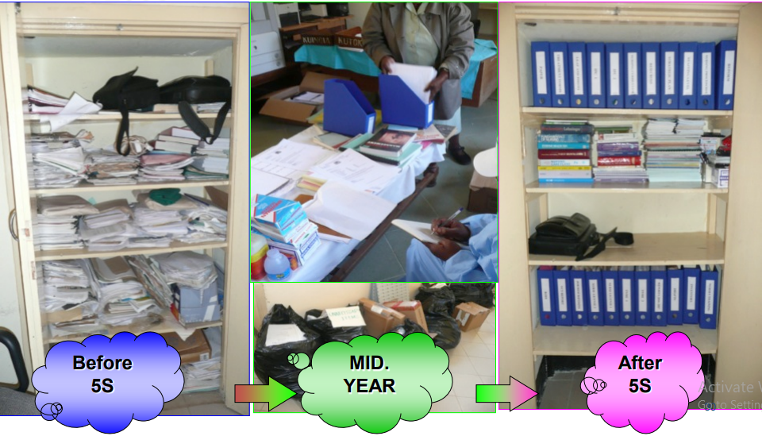
S-2 SEITON EXAMPLES

Slide 12
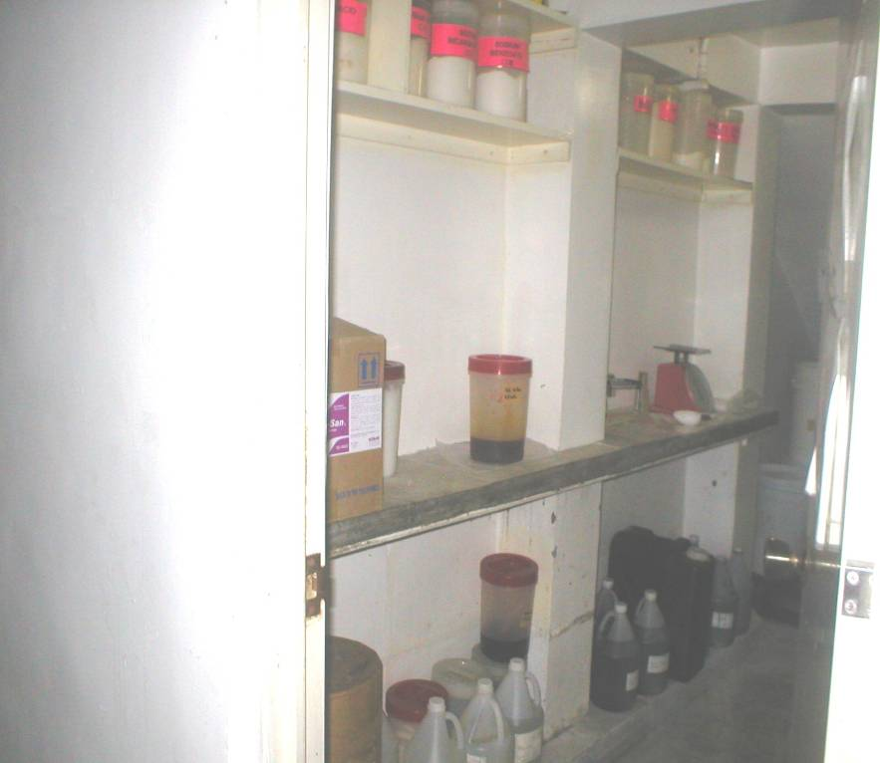
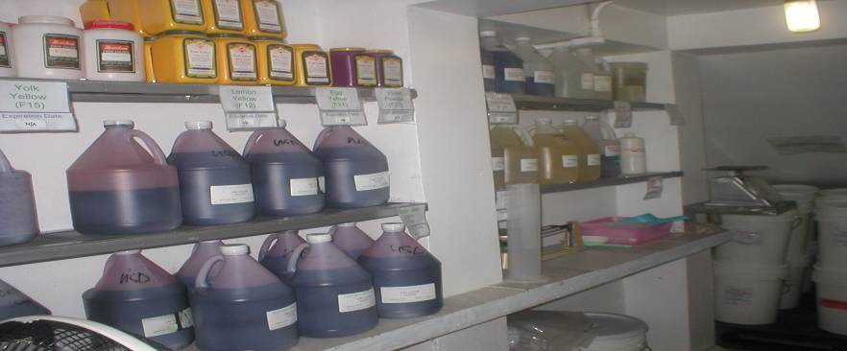
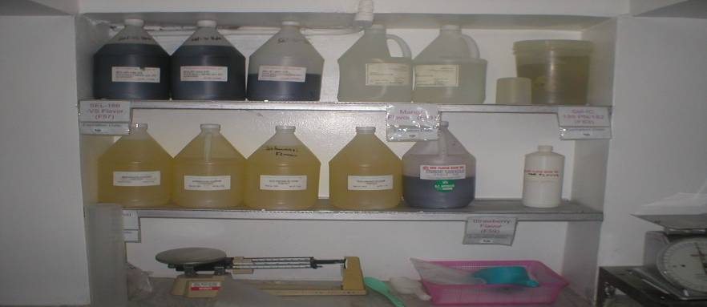
Systematize Thru organized storage and labeling of Raw Materials
BEFORE
AFTER
Food Processing Company: Perishable Materials Label with Date Manufactured, Expiration Date and Supplier’s Name with Delivery Date

Slide 13
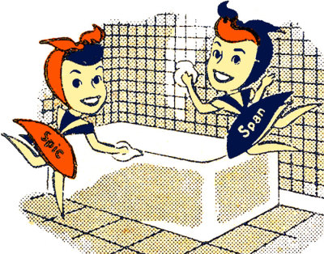
S-3 SEISO (SPIC AND SPAN)
Cleaning up one’s workplace daily so that there is no dust on floors, machines or equipment.
Cleaning + Analysis + Solution = Nice Working Environment

Slide 14
S-3 SEISO EXAMPLES
Regular cleaning and maintenance of equipment, tools and facilities
Periodical check for changes in equipment and the service area such as: leaks, vibration, misalignment, breakage etc.

Slide 15

S-4 SEIKETSU (STANDARDIZE)
Maintain an environment where S1 to S3 are implemented in the same manner throughout the organization
Develop mechanism to standardize
S1-S3 implementation for continuation

Slide 16

S-5 SHITSUKE (SELF-DISCIPLINE)
Maintain S1-S4 through discipline, commitment and empowerment
It focuses on defining a new mindset and a standard in workplace

Slide 17
S-5 SHITSUKE EXAMPLE
Regular progress reporting
• Refresher training
• Periodical evaluation of 5S activities with proper advices for continuation and further improvements
• Appreciation, recognition and awarding on good 5S activities
• Reminder using 5S corner, new letters, good practice sheet etc.

Slide 18


WHY 5S?
Improves productivity
Improves safety
Work becomes easier
People become disciplined
Generates more business
Workplace becomes cleaner and organized

Slide 19
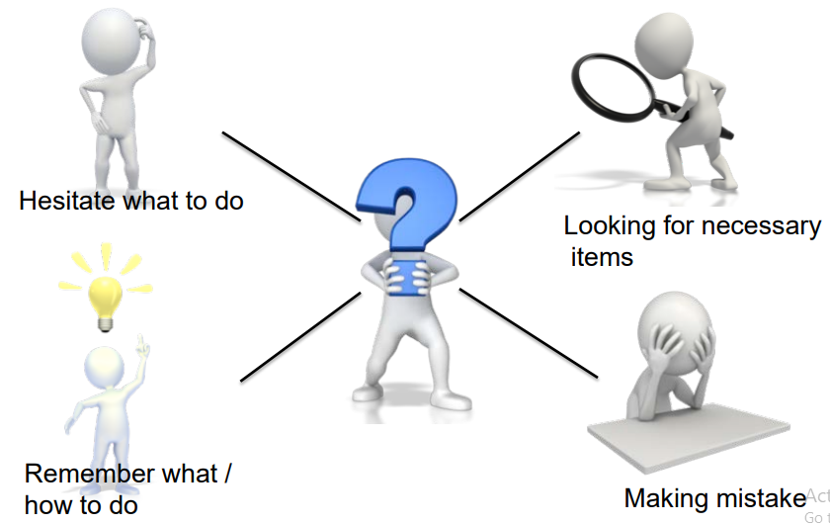
IF THERE’S NO 5S:

Slide 20
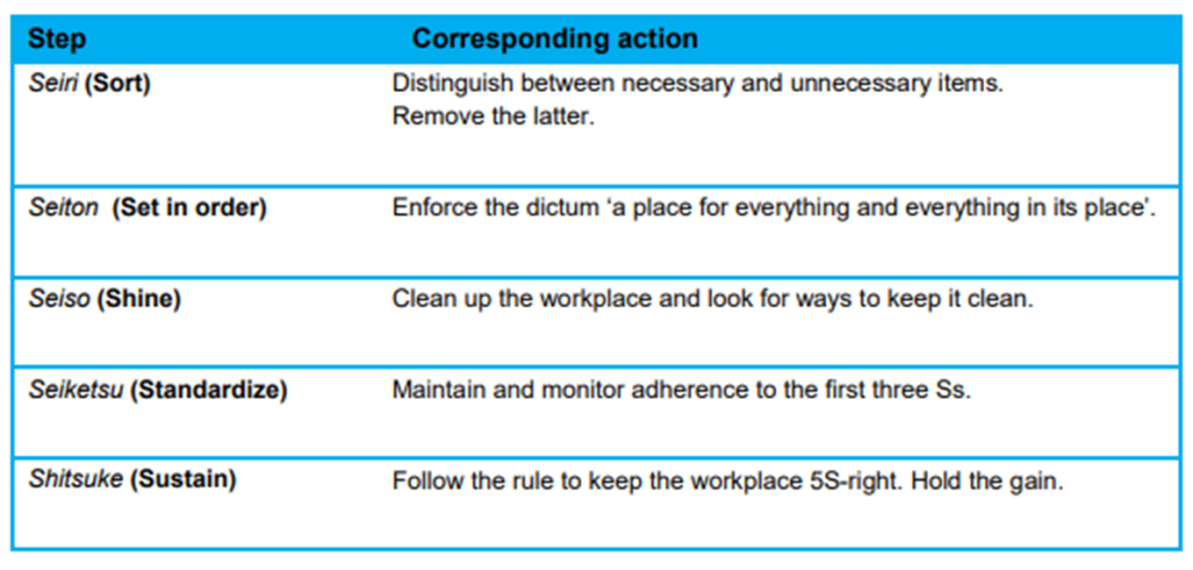
SYNTHESIS
Notes:
Muda - is any activity or process that does not add value; a physical waste of your time, resources and ultimately your money.
Mura - put unfair demands on our processes and people and cause the creation of inventory and other wastes.
Muri - to give unnecessary stress to our employees and our processes.

Slide 21


To ensure that you have learned something about our topic, let’s take a short quiz!

Slide 22
QUIZ
1. In your own words, define what 5S Practice is.

Slide 23
QUIZ
2. Explain each basic concept of 5S practice.
Muda
Mura
Muri

Slide 24
QUIZ
3. If you were to implement 5s program/activity in the office, how will you do it? What inspirational or motivational strategy will you use to encourage employees to apply 5s?

Slide 25
End of Presentation
THANK YOU!
Visit us
www.pcl.com.ph

